Slide 1
LESSON 5 INTRO TO COMPUTATION
CSc 304
Stephen Lucci

Slide 2
In Lesson 1 we discussed the concept of
Cardinality, Counting, Bijection, Injection, Surjection, Finite, Infinite, Domain, Codomain, Countable, Denumerable
Countably infinite, Uncountable infinite, Uncountable, Enumeration with/without repetitions, Lexicographical ordering, Proof by contradiction
Algorithm: as a definite, effective procedure that is guaranteed to halt. It generally has both input and outputs.
There are algorithms for: Sorting, Searching, Matrix Multiplication, Tree and Graph Traversal

Slide 3
Decision Problems - revisited
Consider once again, the question template:
Is natural number n a prime number?(*)
When n is instantiated with a numeric value, we have an instance of this problem.
Example:
Is natural number 6 a prime number? (**)
Any problem whose answer is either YES or NO is a decision problem
The decision problem (*) above is a decidable problem as every instance may be answered.
The answer to the instance (**) is NO as 6 is composite (6=3*2) and therefore not prime

Slide 4
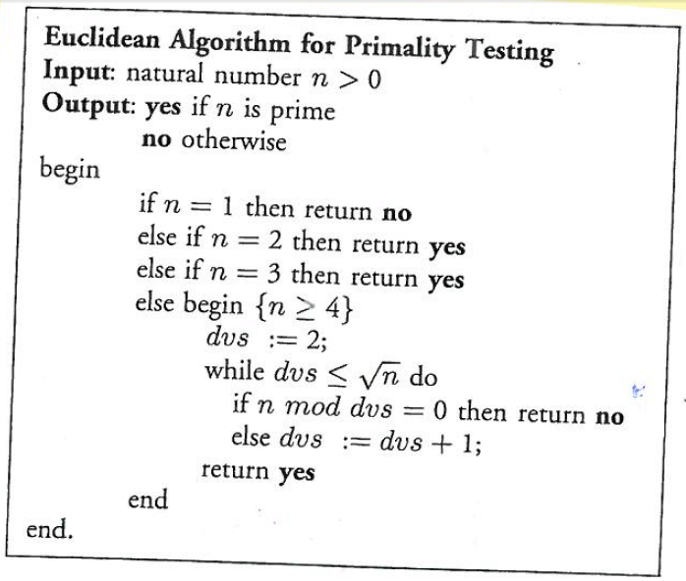
The Euclidean Algorithm for Primality Testing
May be used to answer (decide) these questions for any natural number n>0
Is natural number 8 prime?
dvs:=2
8 mod 2 = 0… return no
Is natural number 11 prime?
dvs:=2
11 mod 2 != 0
dvs:=3
11 mod 3 != 0
dvs:= 4
return yes

Slide 5
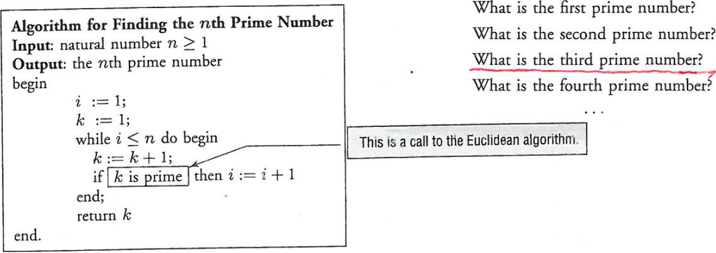
What is the …?

Slide 6
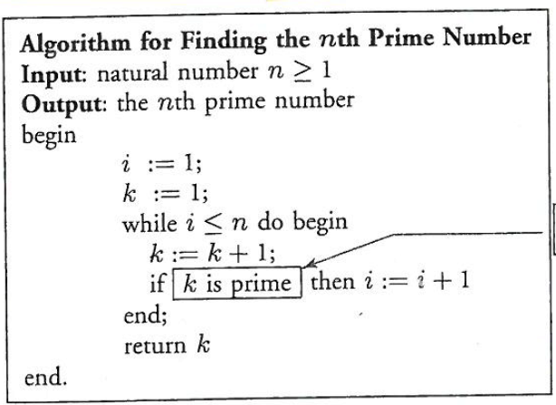
What is the third prime number?
i=1
k=1
i<=3
If k prime
i=2
i <=3
k=3
If k prime
i=3
i<=3
k=5
return 5 //is the third prime

Slide 7
Number-Theoretic Functions
The unary number theoretic function f defined by:
f(n) = def // the nth prime number
f belongs to the class of computable functions
f(1) = 2, f(2) = 3, f(3)=5
Given any natural number n, one can find the value of f for arguments using an algorithm similar to what we just saw
Definition: A number theoretic function:
f = ℕ -> ℕ // unary
f = ℕ² -> ℕ // binary
f = ℕ^{n} -> ℕ // n-ary
Function computation paradigm
One approach when thinking about computation

Slide 8
The Language Recognition Paradigm
A second approach to computation: is the following string ω over Σ={a,b} a palindrome?
abbabbabba
How would you approach this problem? On a FSM? PDA? Tm? Digital Computer?
We might use symbol manipulation
Another example of symbol manipulation
Is the following string ω over Σ={a,b,c}* of the form: a^{n}b^{n}c^{n} where n>=1?
The language recognition paradigm

Slide 9
The Transduction Paradigm
Involves some well-defined transformation of symbols strings.
e.g. input ω = ababbb
output = ω^{r} = bbbaba
Three computation paradigms
Function Computation
Symbol manipulation or language recognition
Transduction
In-principle computability – when we are not concerned with space and time requirements – but only can it be done? Emphasis on function computation
When space and time requirements are tantamount then emphasis is on language recognition or transduction paradigms
Interreducibility of the three models
Transduction is considered as a function computation f(ω) = ω^{r}

Slide 10
Feasible Computation
Computability in principle vs computational feasibility
Computability in principle – can we solve it? Period
Computational feasibility – can we solve the given problem using a quantity of resources (time and space) that is likely to be available.
Taxonomy of problems - Solvable Vs Unsolvable
Solvable – an algorithm exist to solve the given problem
Tractable – the algorithm to solve the problem requires a “reasonable” amount of time and space
Intractable – the algorithm requires an infeasible amount of time and space
Probably Intractable
We believe intractable (but no proof exists)
Unsolvable – no such algorithm exists
Note: feasible does not mean cost effective

Slide 11
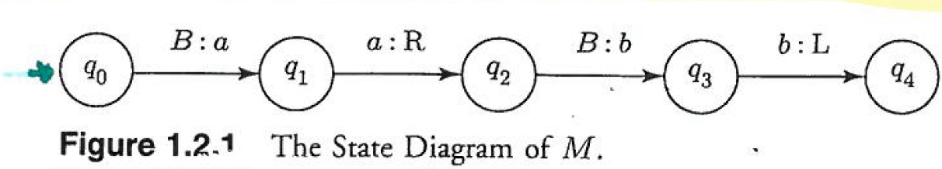
Turing Machines – A Gentle (Re) Introduction
A state diagram for a Turing Machine
Circles denote states e.g. q₂
Start state q₀
Instruction format
Write instructions If M in state q₂ with Blank (B) on cell then write ‘b’ and go to
state q₃
Move instructions If M in state q3 write ’b’ on current cell then move left one
square.
This Turing Machine cannot “walk and chew gum at the same time”
(write or move not both!)

Slide 12
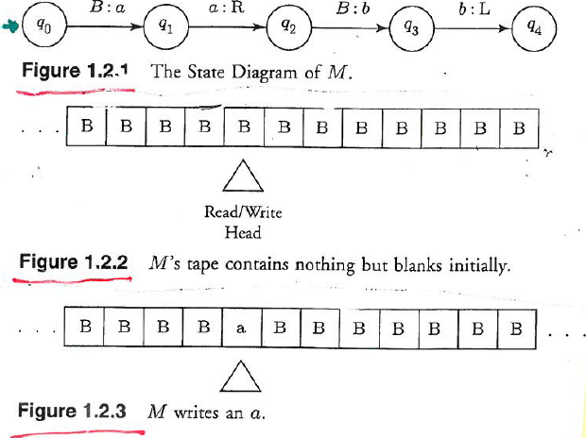
M’s tape is initially all blank

Slide 13
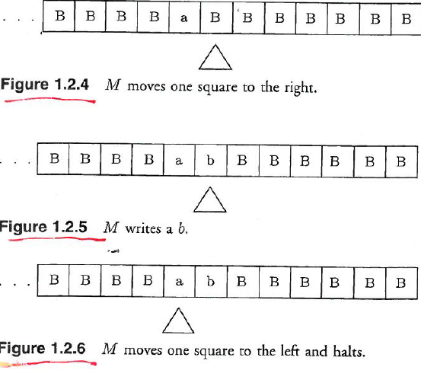
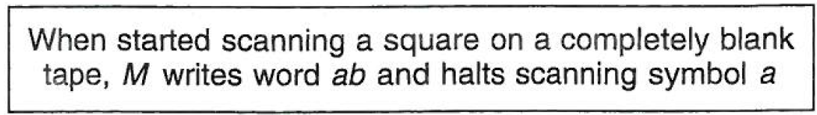

Slide 14
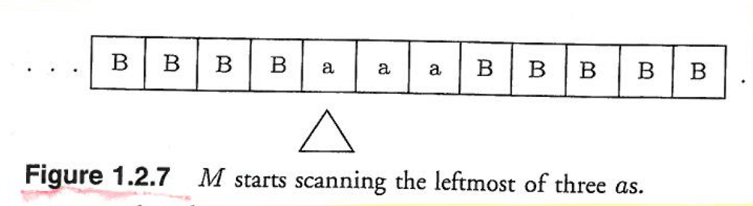

Slide 15
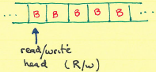
Turing Machines – Gently Re-Introduced Cont
M has one state
If M begins on an entirely blank tape (as
shown) it will continue moving to the right

Slide 16

Turing Machines – Gently Re-Introduced Cont
M after 4 moves
If we checked M’s progress, next year it would
still be moving right
M is a non-halting Turing machine!

Slide 17

Two-State Turing Machine
If M begins on an entirely blank tape it
will write a ‘1’ and move to the right
endlessly
M is non-halting

Slide 18
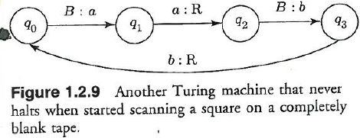
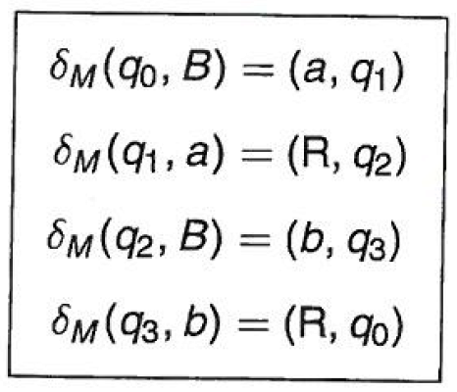
Turing Machine – Cont.
State Diagram
Our shorthand for a trace. (instantaneous descriptions (id)
q₀B|- // many more blanks not shown
// write an ‘a’ go to q₁
q₁aB|-
// scan an ‘a’ move right one square enter state q₂
aq₂B|-
// write ‘b’ enter q₃
aq₃bB|-
// scan ‘b’ move right re-enter q₀
abq₀B|-*
// a loop
(ab)^{n}q₀B|-*…
State Table – alternative specification for a Turing Machine

Slide 19
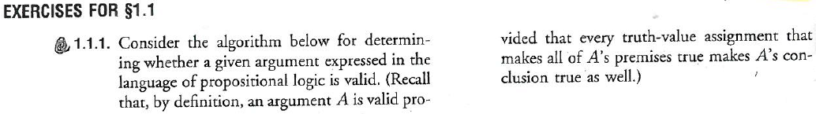
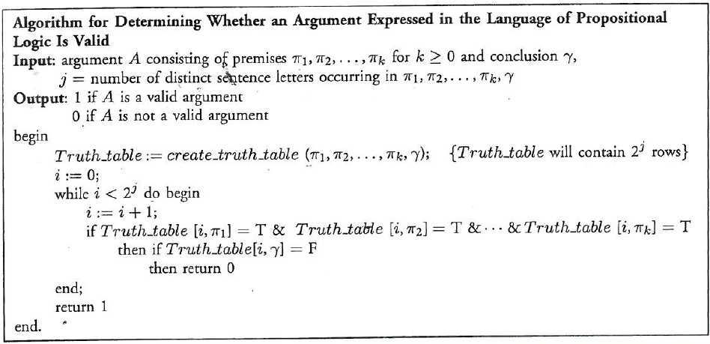
A dash of homework

Slide 20
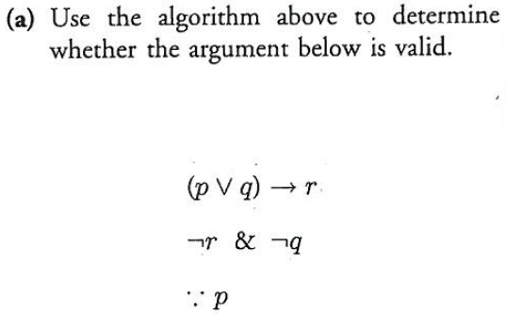
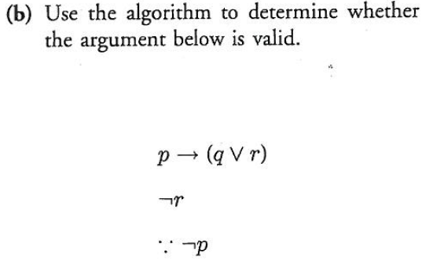
A dash of homework

Slide 21
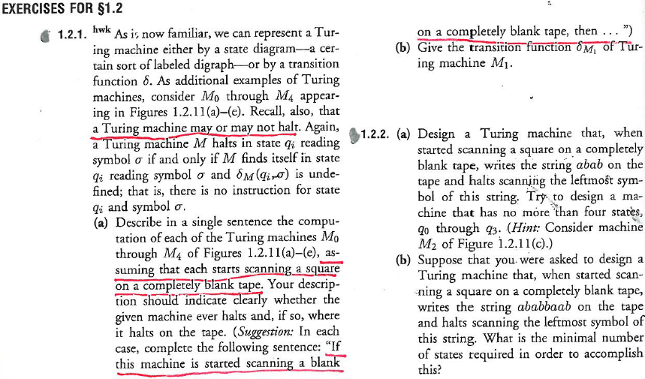
Another dash

Slide 22
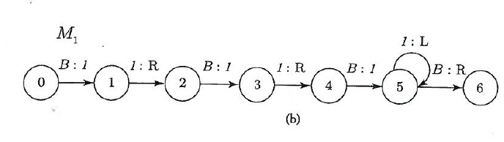
Another dash

Slide 23
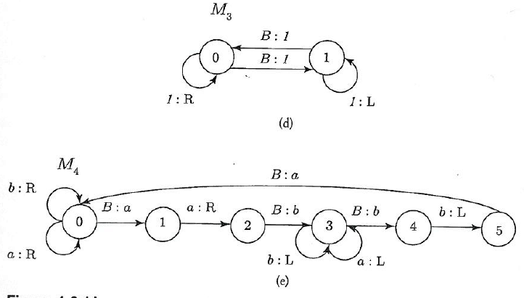
Another dash

